Slide 1
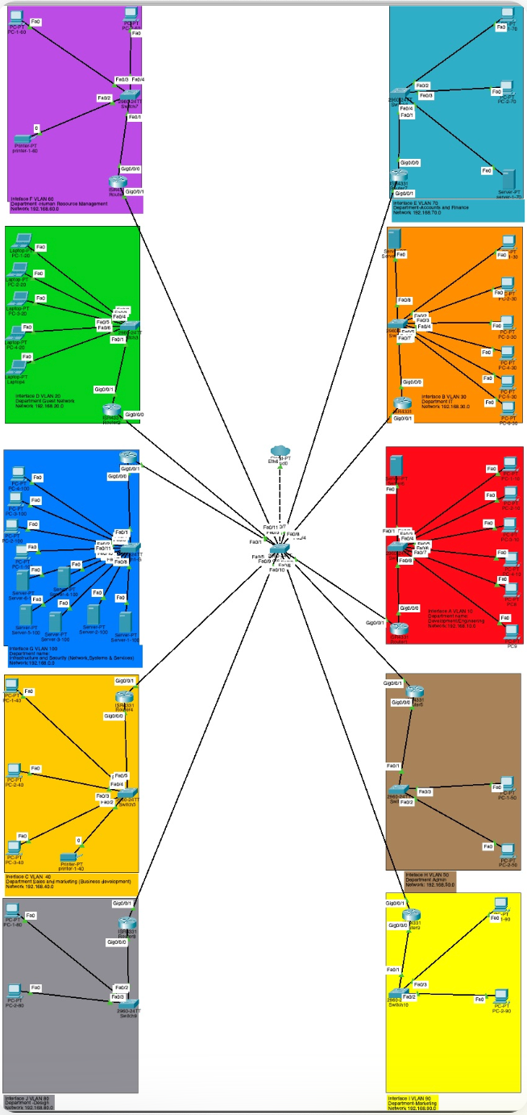
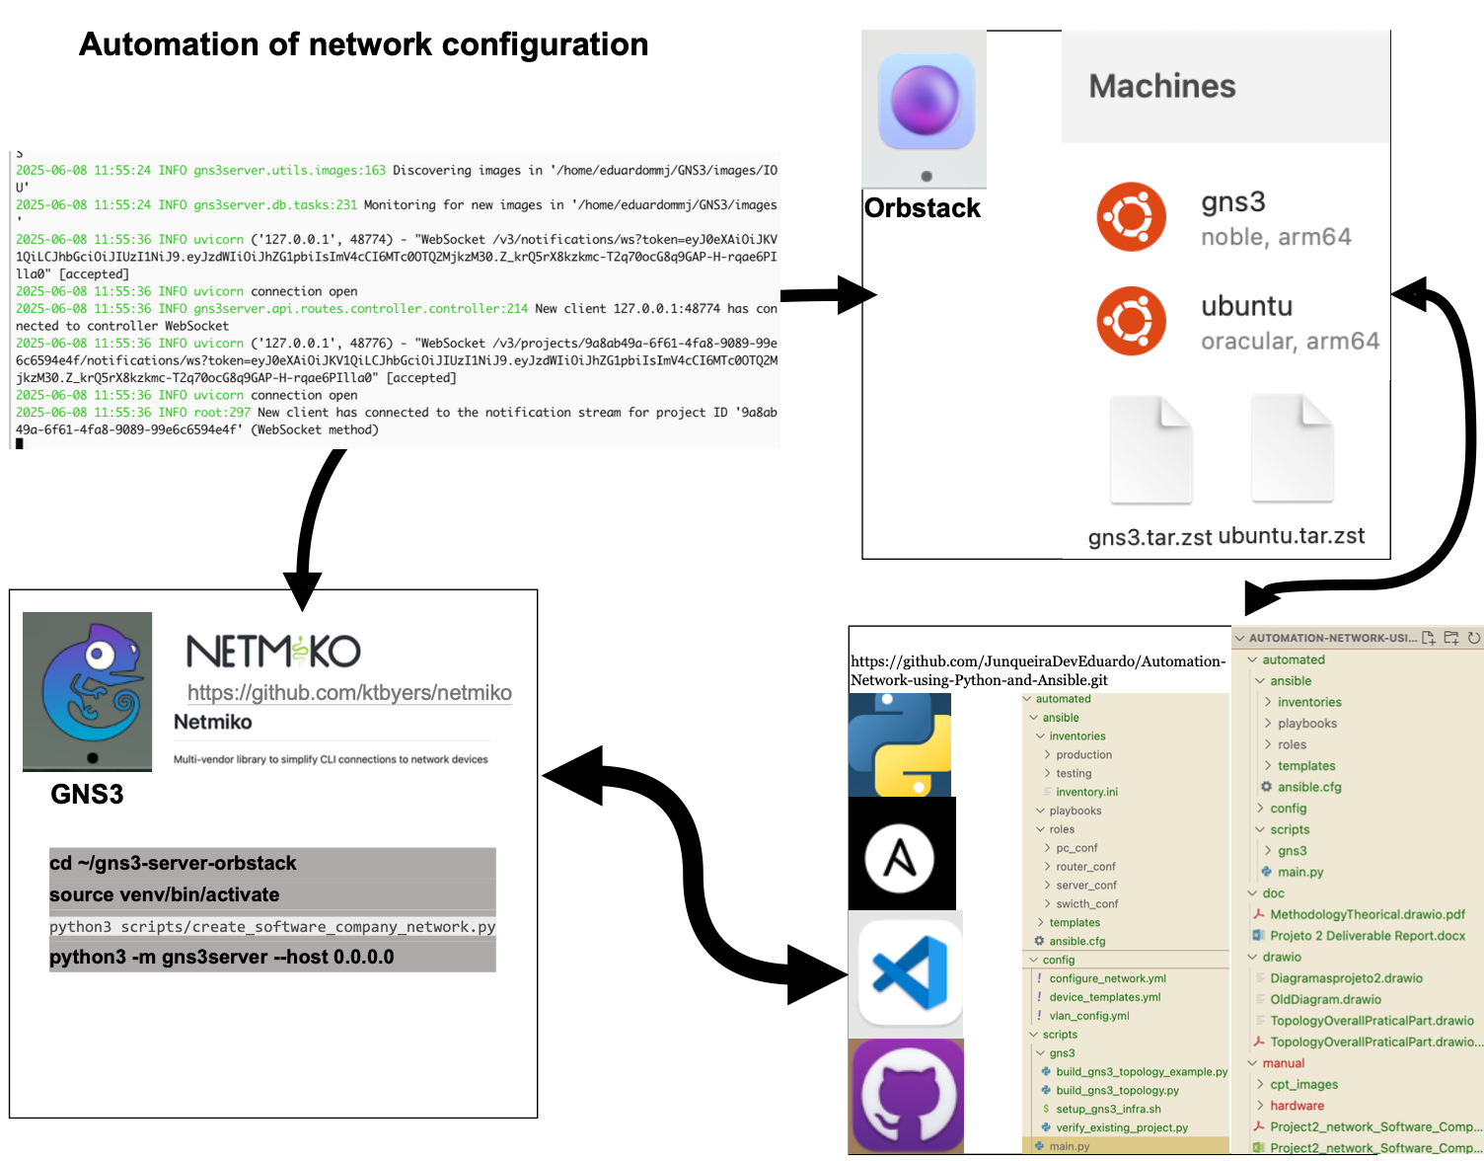
Project 2
Year
2024/2025
Automation of network configuration
Author
Eduardo Junqueira nº30241
Supervision
Nuno Torres
INTRODUCTION
RESULTS
This paper presents the evolution of manual network to automation network configuration.
Evolution from Manual to Automated:
WORK
Here ….
CONCLUSIONS
This project successfully demonstrates the transformation from manual network configuration to fully automated network deployment, providing a comprehensive comparison between traditional and modern network management approaches.
The integration of all tools related are important for the conclusion of this project.
Through overcoming significant technical challenges, particularly in Apple Silicon compatibility, this project demonstrates that network automation is achievable across diverse development environments, making these approaches accessible to a broader range systems.
REFERENCES & LINKS
Pedro Pinto, António Pinto, and Manuel Ricardo. (2015). Cross-layer Admission Control Mechanism to Enhance the Support of Real-time Applications. In IEEE Sensors Journal, vol. 15, no. 12, pp. 6945-6953, Dec. 2015. doi.org/10.1109/JSEN.2015. IF=2.512. Link
REF 2
REF 3
REF 4
REF 5
REF 6

